Slide 1
Network Security
Sritrusta Sukaridhoto
Netadmin & Head of Computer Network Lab
EEPIS-ITS

Slide 2

Tentang aku…
Seorang pegawai negeri yang berusaha menjadi dosen yang baik,...
Senang bermain dengan “Linux” sejak 1999 (kuliah sem 5)
Pengalaman :
  Mengajar
  Penelitian
  Jaringan komputer

Slide 3
Tentang aku lagi…
bergabung dengan EEPIS-ITS tahun 2002
berkenalan dengan Linux embedded di Tohoku University, Jepang (2003 - 2004)
“Tukang jaga” lab jaringan komputer (2004 – sekarang)
Membimbing Tugas Akhir, 25 mahasiswa menggunakan Linux, th 2005 (Rekor)
Tim “Tukang melototin” Jaringan EEPIS (2002 – sekarang)
ngurusin server “http://kebo.vlsm.org” (2000 – sekarang)
Debian GNU/Linux – IP v6 developer (2002)
GNU Octave developer (2002)
EEPIS-ITS Goodle Crew (2005 – sekarang)
Linux – SH4 developer (2004 – sekarang)
Cisco CNAP instructure (2004 – sekarang)
....

Slide 4
Content …
Introduction
Basic Security Architecture
Information gathering
Securing from Rootkit, Spoofing, DoS
Securing from Malware
Securing user and password
Securing Remote Access
Securing Wireless-LAN
Securing network using Encryption
EEPIS-ITS secure network

Slide 5
Introduction

Slide 6

Define security
Confidentiality
Integrity
Availability

Slide 7
Threats…
External
  Hackers & Crackers
  White Hat Hackers
  Scripts Kiddies
  Cyber terrorists
  Black Hat Hackers
Internal
  Employee threats
  Accidents

Slide 8
Type of attacks…
Denial of Services (DoS)
  Network flooding
Buffer overflows
  Software error
Malware
  Virus, worm, trojan horse
Social Engineering
Brute force

Slide 9
Steps in cracking…
Information gathering
Port scanner
Network enumeration
Gaining & keeping root / administrator access
Using access and/or information gained
Leaving backdoor
Covering his tracks

Slide 10
The organizational security process…
Top Management support
  Talk to managent ($$$$$$)
  Hire white hat hackers
  Personal experience from managent
  Outside documents about security

Slide 11
HOW SECURE CAN YOU BE ????
???

Slide 12
Security policy (document)
Commitment top management about security
Roadmap IT staff
  Who planning
  Who responsible
Acceptable use of organizational computer resources
Access to what ???
Security contract with employees
Can be given to new employees before they begin work

Slide 13
Security personnel
The head of organization
  Responsible, qualified
Middle management

Slide 14
The people in the trenches
Network security analyst
  Experience about risk assessments & vulnerability assessments
  Experience commercial vulnerability scanners
  Strong background in networking, Windows & unix environments

Slide 15
The people in the trenches (2)
Computer security systems specialist
  Remote access skills
  Authentication skills
  Security data communications experience
  Web development skills
  Intrusion detection systems (IDS)
  UNIX

Slide 16
The people in the trenches (3)
Computer systems security specialist
  Audit/assessment
  Design
  Implementation
  Support & maintenance
  Forensics

Slide 17
Security policy & audit
Documents
Risk assessment
Vulnerability testing
Examination of known vulnerabilities
Policy verification

Slide 18
Basic Security Architecture

Slide 19
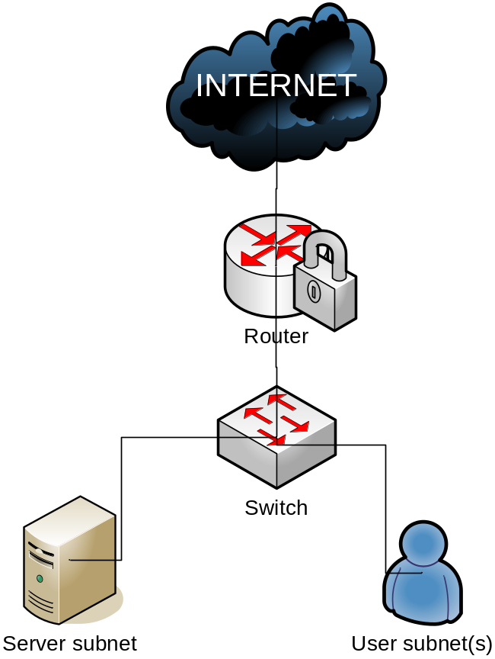
Secure Network Layouts

Slide 20
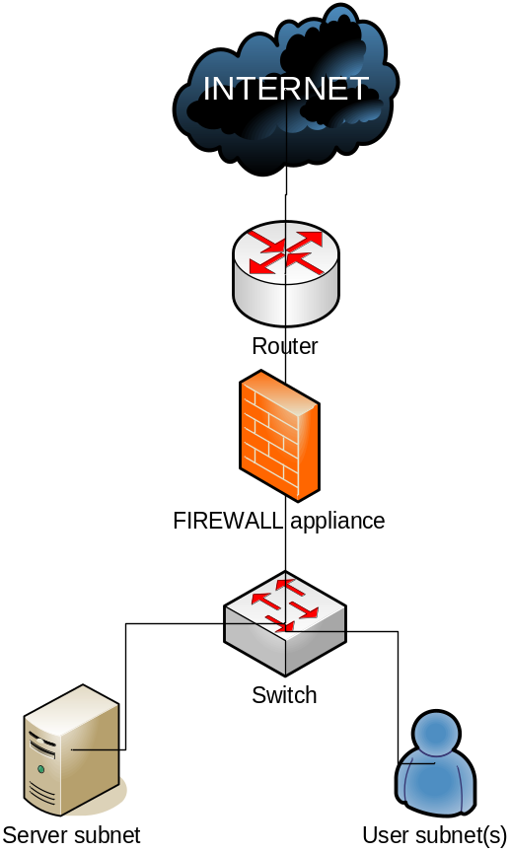
Secure Network Layouts (2)

Slide 21
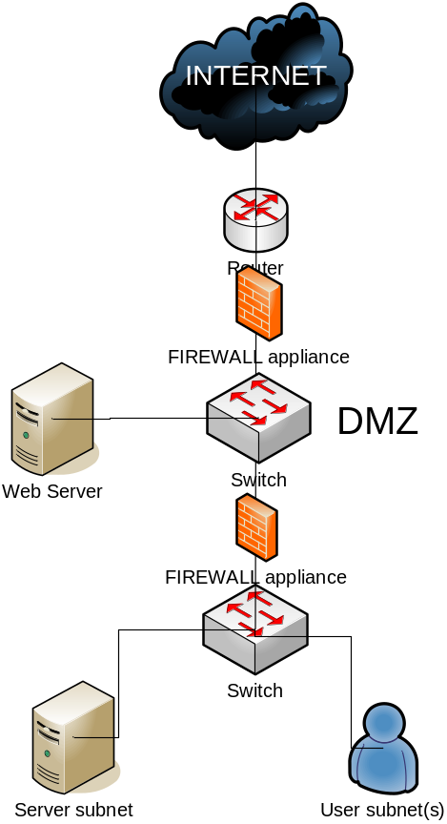
Secure Network Layouts (3)

Slide 22
Firewall
Packet filter
Stateful
Application proxy firewalls
Implementation:
  iptables

Slide 23
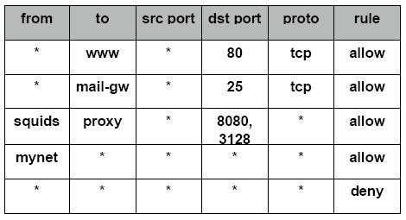
Firewall rules

Slide 24
File & Dir permissions
Chown
Chmod
Chgrp

Slide 25
Physical Security
Dealing with theft and vandalism
Protecting the system console
Managing system failure
  Backup
  Power protection

Slide 26
Physical Solutions
Individual computer locks
Room locks and “keys”
Combination locsks
Tokens
Biometrics
Monitoring with cameras

Slide 27
Disaster Recovery Drills
Making test
  Power failure
  Media failure
  Backup failure

Slide 28
Information gathering

Slide 29
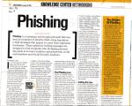
How
Social Engineering
    What is user and password ?
  Electronic Social engineering: phising

Slide 30
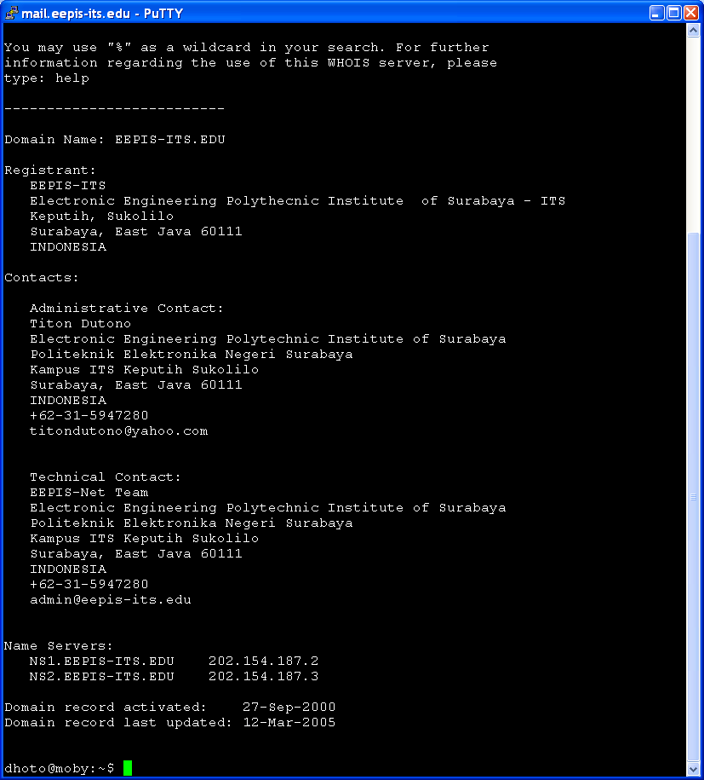
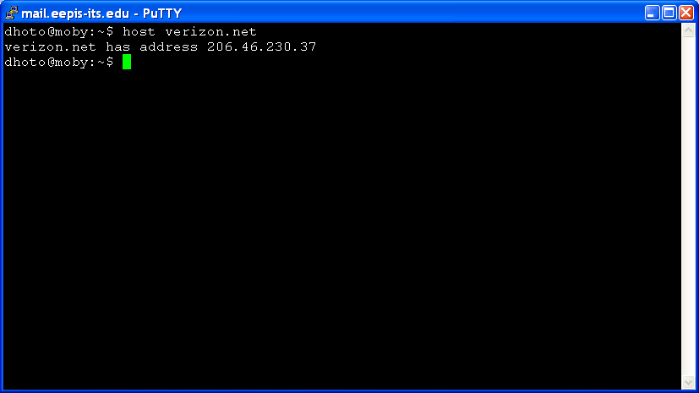
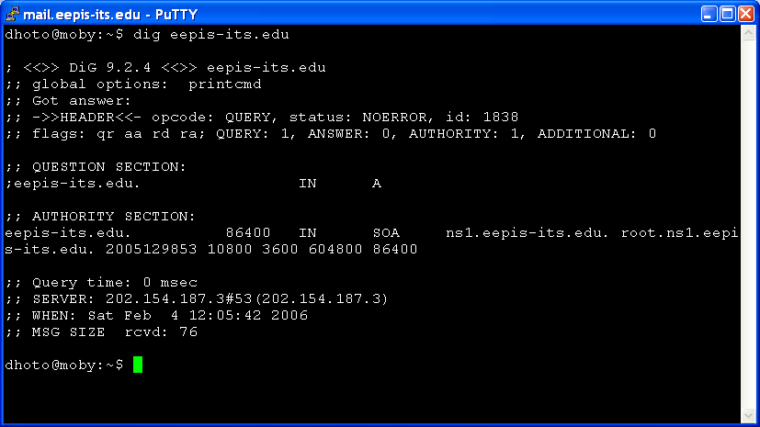
Using published information
Dig
Host
whois

Slide 31
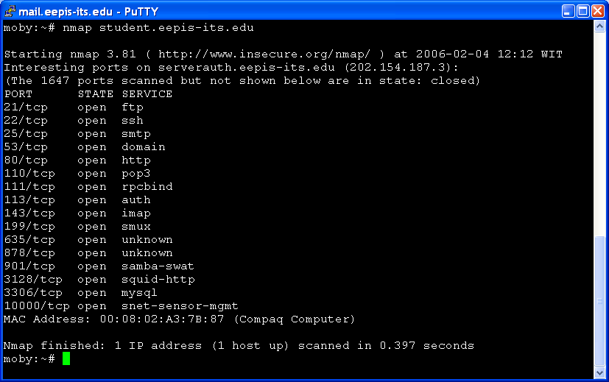
Port scanning
Nmap
  Which application running

Slide 32
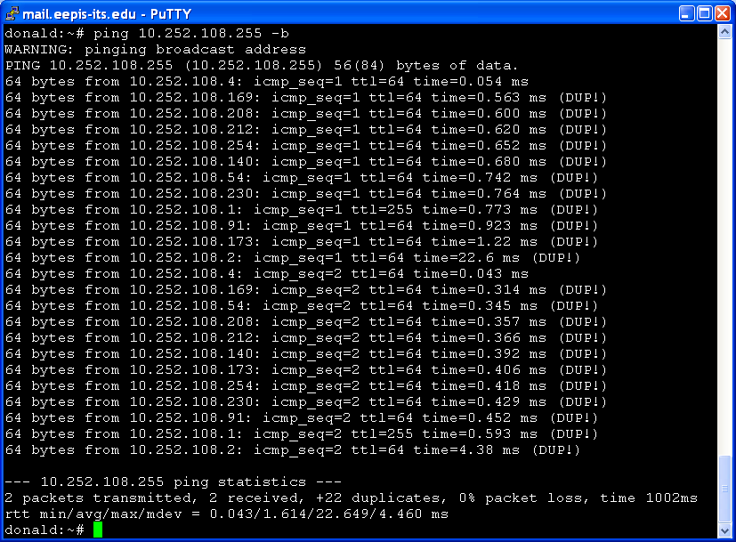
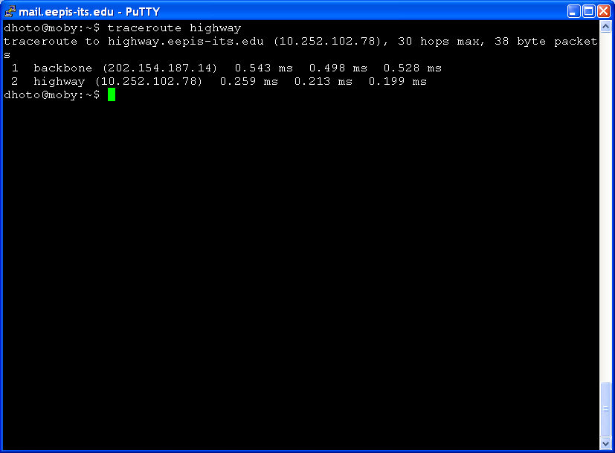
Network Mapping
Icmp
  Ping
  traceroute

Slide 33
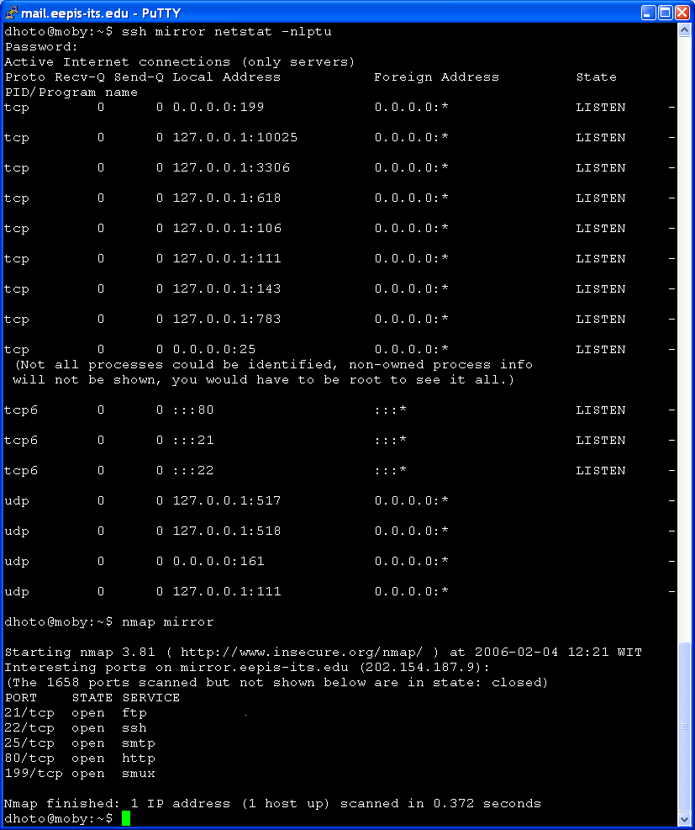
Limiting Published Information
Disable unnecessary services and closing port
  netstat –nlptu
  Xinetd
Opening ports on the perimeter and proxy serving
  edge + personal firewall

Slide 34
Securing from Rootkit, Spoofing, DoS

Slide 35
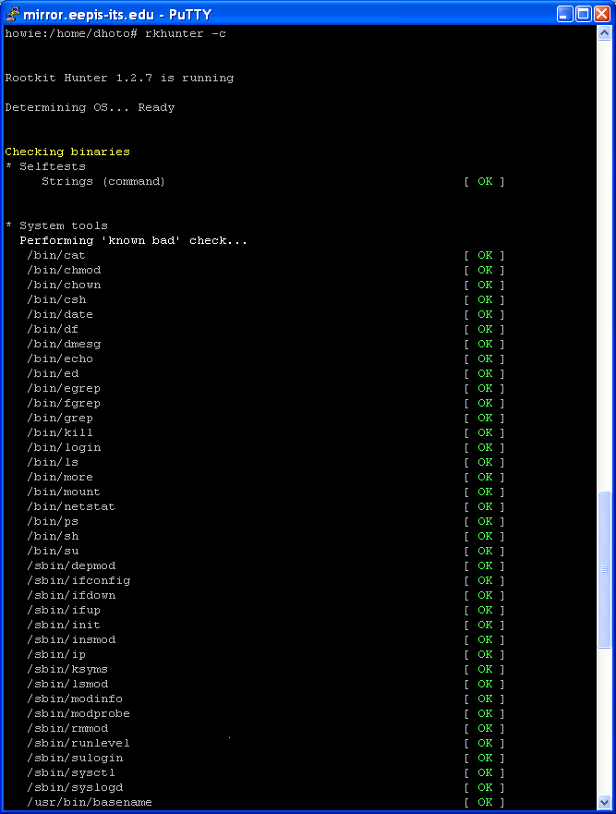
Rootkit
Let hacker to:
Enter a system at any time
Open ports on the computer
Run any software
Become superuser
Use the system for cracking other computer
Capture username and password
Change log file
Unexplained decreases in available disk space
Disk activity when no one is using the system
Changes to system files
Unusual system crashes

Slide 36
Spoofprotect
Debian way to protect from spoofing
/etc/network/options
Spoofprotect=yes
/etc/init.d/networking restart

Slide 37
DoS preventive
IDS
IPS
Honeypots
firewall

Slide 38
Intrusion Detection Software (IDS)
Examining system logs (host based)
Examining network traffic (network based)
A Combination of the two
Implementation:
  snort

Slide 39
Intrusion Preventions Software (IPS)
Upgrade application
Active reaction (IDS = passive)
Implementation:
  portsentry

Slide 40
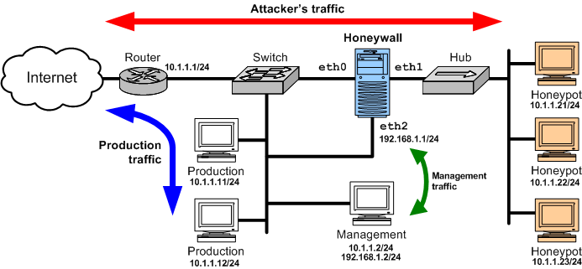
Honeypots
(http://www.honeynet.org)

Slide 41
Securing from Malware

Slide 42
Malware
Virus
Worm
Trojan horse
Spyware
On email server :
  Spamassassin, ClamAV, Amavis
On Proxy server
  Content filter using squidguard

Slide 43
Securing user and password

Slide 44
User and password
Password policy
Strong password
Password file security
  /etc/passwd, /etc/shadow
Password audit
  John the ripper
Password management software
  Centralized password
  Individual password management

Slide 45
Securing Remote Access

Slide 46
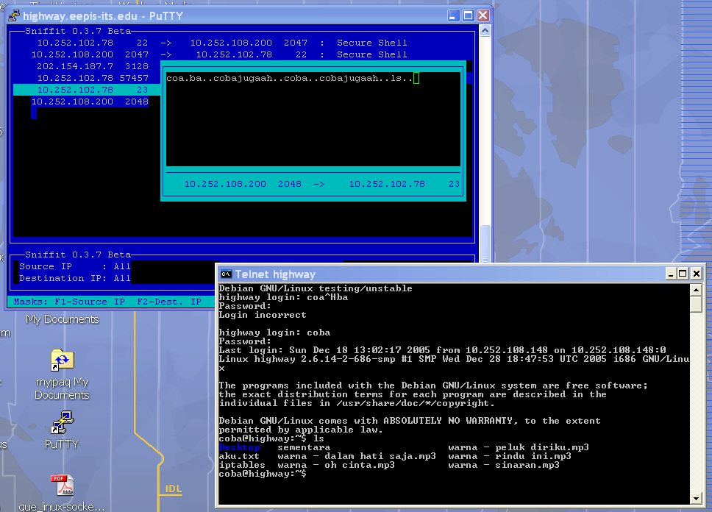
Remote access
Telnet vs SSH
VPN
  Ipsec
    Freeswan
    Racoon
  CIPE
  PPTP
  OpenVPN

Slide 47
Wireless Security
Signal bleed & insertion attack
Signal bleed & interception attack
SSID vulnerabilities
DoS
Battery Exhaustion attacks - bluetooth

Slide 48
Securing Wireless-LAN

Slide 49
802.11x security
WEP – Wired Equivalency Privacy
802.11i security and WPA – Wifi Protected Access
801.11 authentication
EAP (Extensible Authentication Protocol)
Cisco LEAP/PEAP authentication
Bluetooth security – use mode3

Slide 50
Hands on for Wireless Security
Limit signal bleed
WEP
Location of Access Point
No default SSID
Accept only SSID
Mac filtering
Audit
DHCP
Honeypot
DMZ wireless

Slide 51
Securing Network using Encryption

Slide 52
Encryption
Single key – shared key
  DES, 3DES, AES, RC4 …
Two-key encryption schemes – Public key
  PGP
Implementation
  HTTPS

Slide 53
EEPIS-ITS secure network

Slide 54
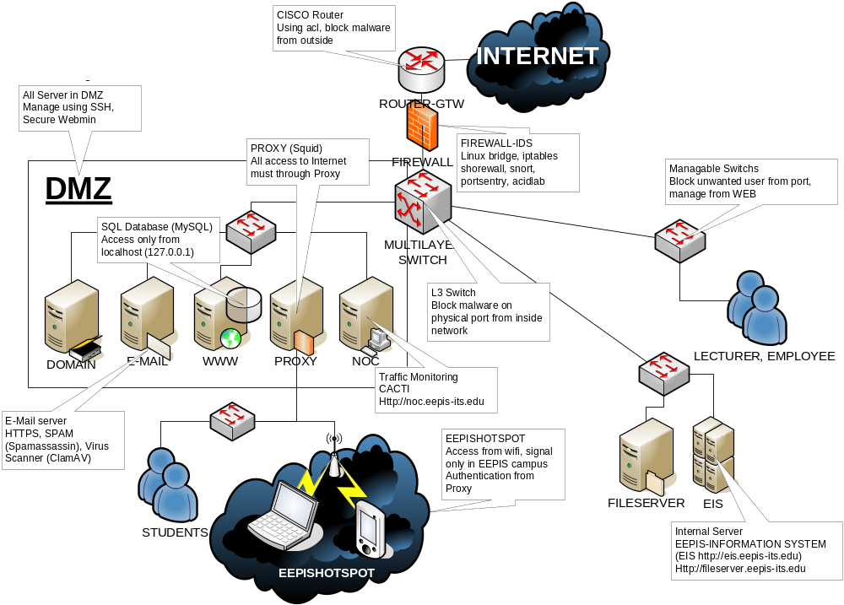

Slide 55
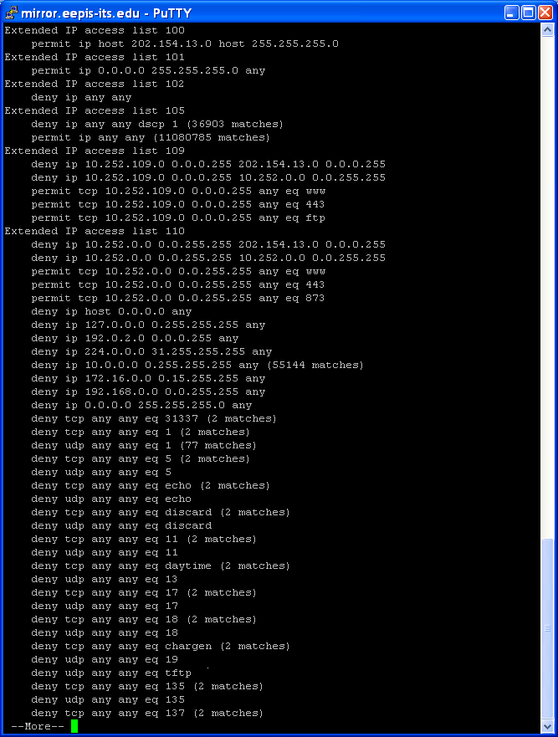
Router-GTW
Cisco 3600 series
Encrypted password
Using “acl”

Slide 56
Linux Firewall-IDS
Bridge mode
  Iface br0 inet static
    Address xxx.xxx.xxx.xxx
    Netmask yyy.yyy.yyy.yyy
    Bridge_ports all
Apt-get install snort-mysql webmin-snort snort-rules-default acidlab acidlab-mysql
Apt-get install shorewall webmin-shorewall
Apt-get install portsentry

Slide 57
Multilayer switch
Cisco 3550
CSC303-1#sh access-lists
Extended IP access list 100
permit ip 10.252.0.0 0.0.255.255 202.154.187.0 0.0.0.15 (298 matches)
deny tcp any 10.252.0.0 0.0.255.255 eq 445 (1005 matches)
Extended IP access list CMP-NAT-ACL
Dynamic Cluster-HSRP deny ip any any
Dynamic Cluster-NAT permit ip any any
permit ip host 10.67.168.128 any
permit ip host 10.68.187.128 any

Slide 58
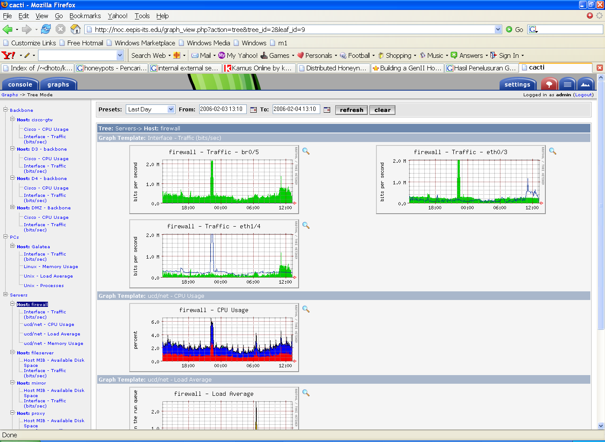
NOC for traffic monitoring

Slide 59
E-Mail
reject
Smtp
Postfix
DNS
SERVER
Amavis
Smtp
Parsing
ClamAV
Open relay
Spamasassin
RBL
secure
SPF
Virtual
MAP
http 80
insecure
ok
ok
N
Y
Secure
https
443
N
Y
User A
Quarantine
User B
maildir
Pop before
smtp
User C
Pop 3
courier
Courier
imap
Outlook
/
Squirrelmail
DIAGRAM ALUR POSTFIX

Slide 60
Policy
No one can access server using shell
Access mail using secure webmail
Use proxy to access internet
No NAT
1 password in 1 server for many applications

Slide 61
Thank you
dhoto@eepis-its.edu

